Slide 1


Pittsburgh Pennsylvania 311 Data analysis
Alan Dalton, Firouz (Phil) Karimov, Jacqueline Williams

Slide 2
Motivation and summary
“Why 311 data?” – 911 data would just have been too large…
Some of the questions we had
What are the top call types?
Were there any neighborhoods with a higher call-in rate?
If so, are there any economical correlations such as household income?
Do certain times of year have higher request?
Can weather events affect number of request?
With our questions, we were off with our exploration.

Slide 3
Data Cleanup and exploration
Using the Data.Gov site, we located a CSV file representing 311 Data for Pittsburgh, PA(over 300K data set).
After combining all data, we cleaned (NaN), and Nulls
Reduce to the top 5 Neighborhoods and Call Request Type
Reformatted date/time to YY/MM
With provided lat and longitudes we accessed the Google GEOcoding API and were able to pull in zip codes .
Once we had the zip codes, we then were able to get the financial data through the Census API .

Slide 4
Technology used
Data.gov CSV file of 311 data
Census API
Google Places API
Pandas to create DataFrame
Matplotlib to create charts
Python Libraries as necessary

Slide 5
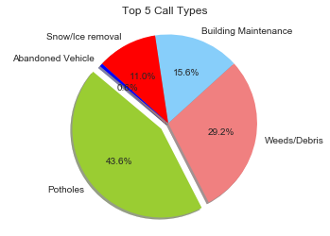

Top 5 call types
The pie chart provided immediate visibility of Top Call Types.
Query:
request_top = df['REQUEST_TYPE'].value_counts()[:5]
plt.title("Top 5 Call Types", y=1.02);
colors = ['yellowgreen', 'lightcoral', 'lightskyblue', 'red', 'blue']
explode = (0.1, 0, 0, 0, 0)
plt.pie(request_top, explode=explode,
labels=request_top.index,
colors=colors,
autopct='%1.1f%%', shadow=True, startangle=140)
plt.axis('equal')
plt.show();

Slide 6
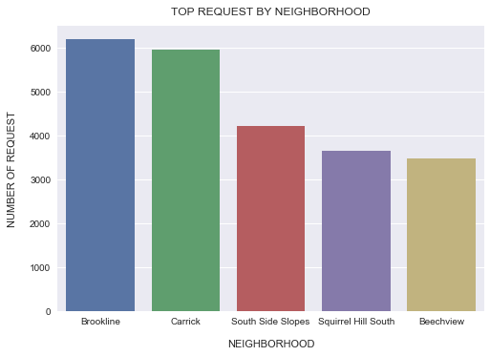
Top 5 Neighborhood's
A Bar Chart quickly helped identify the Neighborhood placement for calls giving indication Bookline and Carrick were a good starting point for economic research.
Query:
neighbor_top = df['NEIGHBORHOOD'].value_counts()[:5]
neighbor_top_df = pd.DataFrame({"neighborhood":neighbor_top.index,"request":neighbor_top})
sns.barplot(x="neighborhood", y="request", data=neighbor_top_df)
plt.xlabel("NEIGHBORHOOD", labelpad=14)
plt.ylabel("NUMBER OF REQUEST", labelpad=14)
plt.title("TOP REQUEST BY NEIGHBORHOOD", y=1.02)

Slide 7
Call count by YY/Month
Using the “Radar Chart” within excel, we can quickly see a spike on Jan 2018 for Snow/Ice removal.
This was followed by Potholes and another Pothole spike in April of 2018 as winter ends.

Slide 8
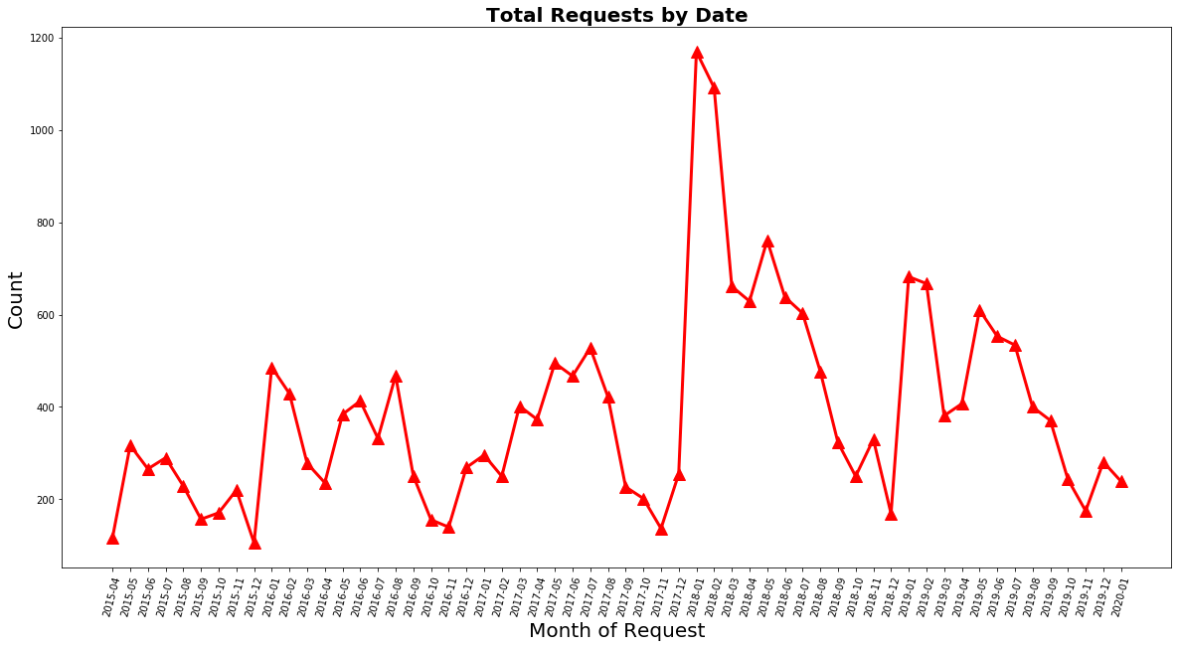
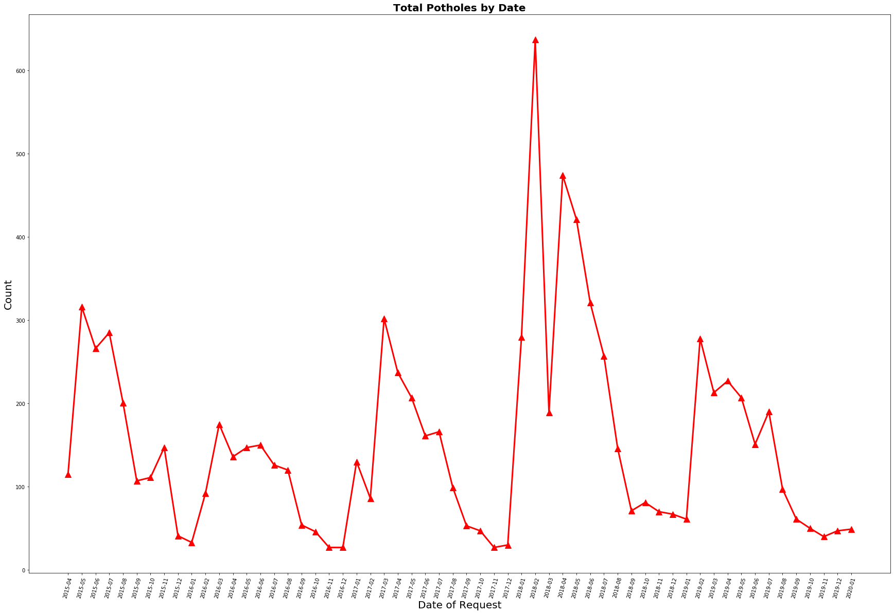
Call count by Date Breakdown

Slide 9
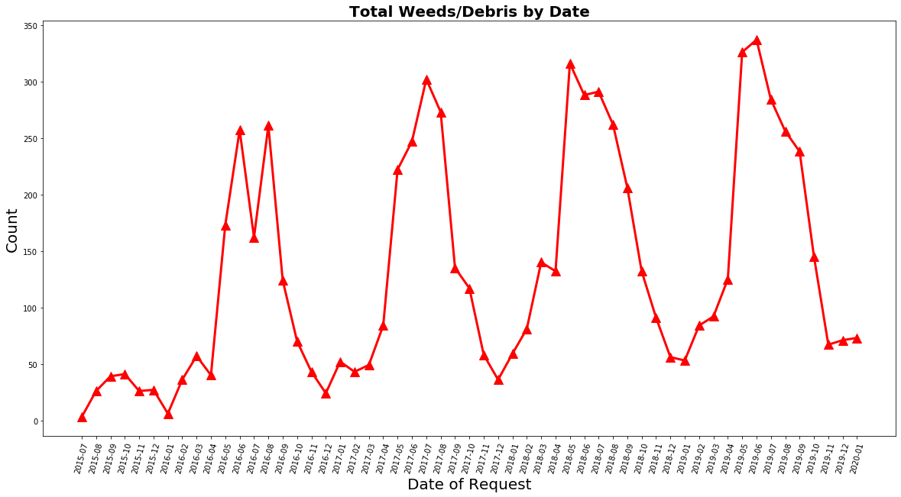
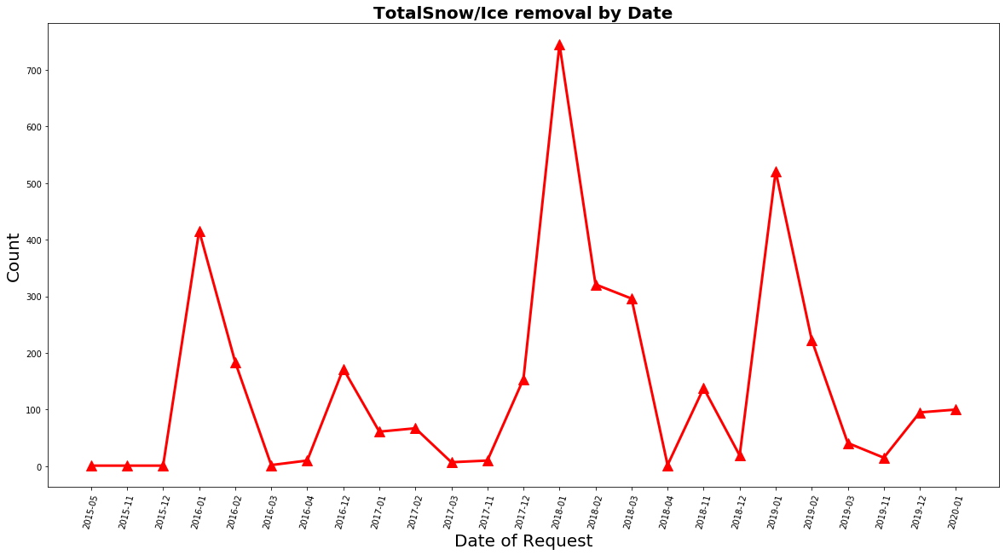
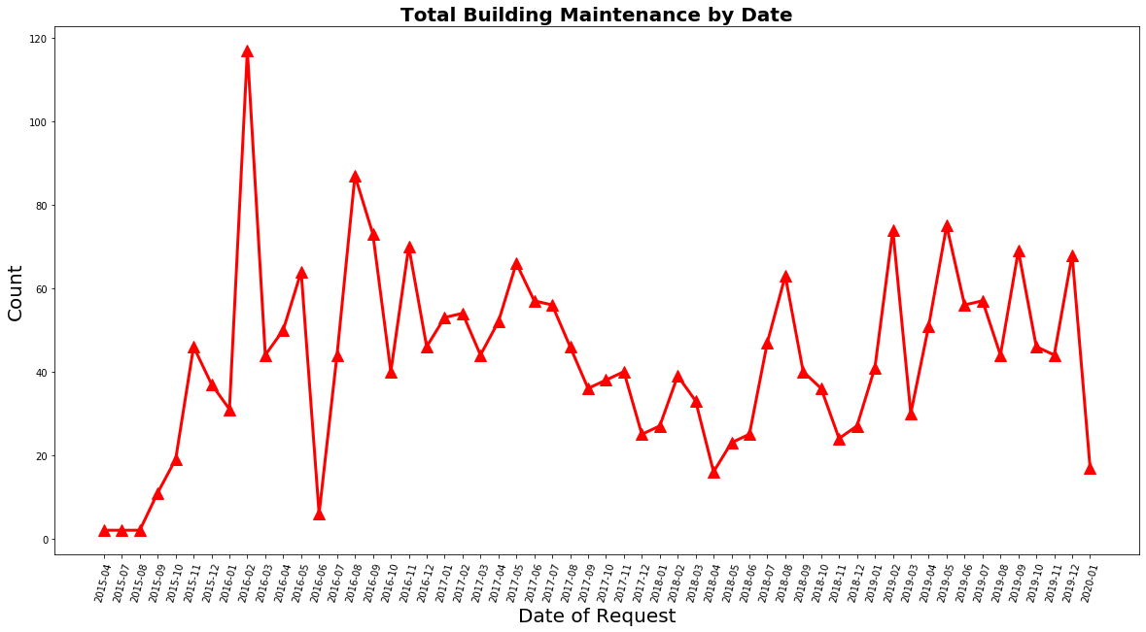

Slide 10
Economics
Now we know our top 5 call types and the neighborhoods making the calls, can we find a correlation?

Slide 11
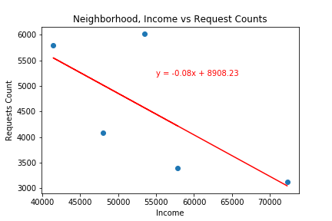
Neighborhood income vs call Request
Although very few data points, with the Splatter plot, we can easily see how the lower income levels have higher call in request
With provided lat/lng’s we accessed the Google GEOcoding
API and were able to pull in zip codes .
We then accessed the Census API and with the zip codes were able to collect social economic data.

Slide 12
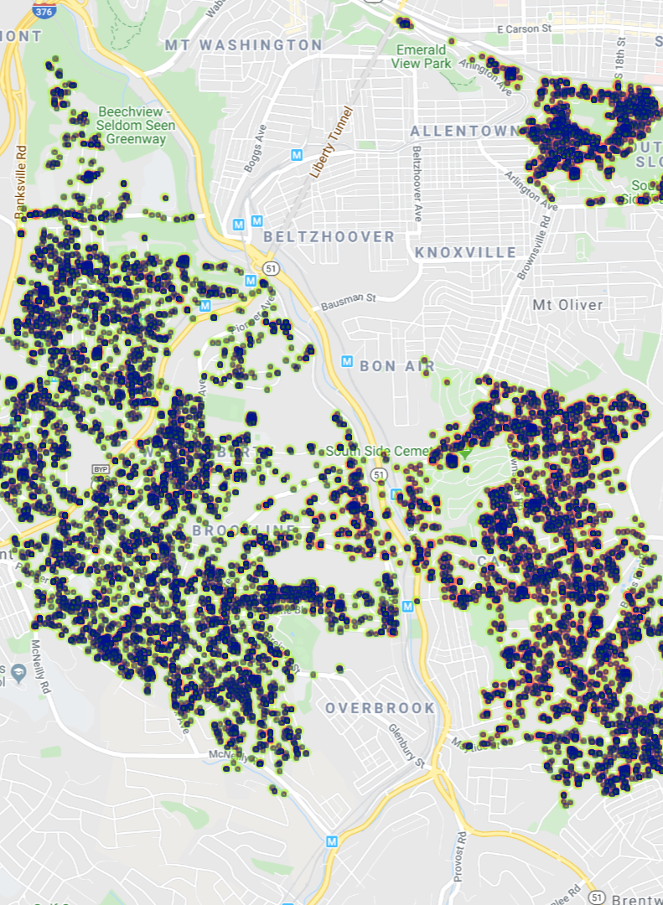
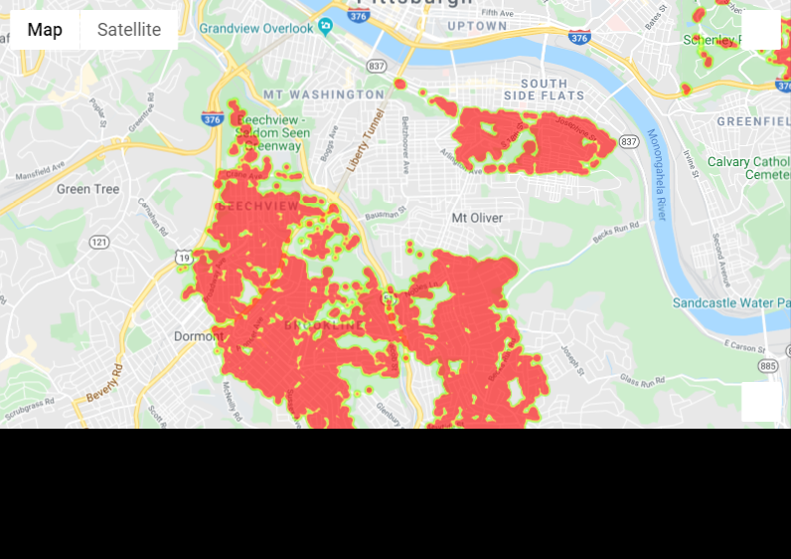
Economical correlations
South Side Slopes
South Side Slopes
Brookline
Carrick
Carrick
Brookline
Area’s of Poverty
Using google API and Census data, we brought down the call request by Lat and Lng.
Poverty data based on Census data
Originating Call Request

Slide 13
Conclusion
Did we find what we expected? Anything unexpected?
The original file was labeled as Philadelphia but when we were cleaning data and pulling zip codes, we realized it all was really for Pittsburgh.
The CSV file being 300K+ records had API calls to google taking multiple hours, so sometimes it’s better to clean data sooner rather than later.
Conclusions we can pull from analysis
In January 2018 there was an obvious spike in Snow/Ice removal followed by spikes for Potholes in Feb and April of 2018 perhaps proving snow and ice do cause potholes….
The lowest income neighborhoods have the highest call in rate, so do they receive the same amount of service as wealthier neighborhoods i.e., road maintenance?
Potholes are always the majority but do tend to spike during winter and spring months
We do know from additional research, in Jan of 2018 Pittsburgh received 17 inch of snow and a lot of days with freezing fog

Slide 14

questions
?

